Slide 1
“Musical Instrument System”
Submitted By :-
Name :- Dhananjay Manik Bhagat
Division :- C
Seat No :- 21714

Slide 2
Existing System
Present System is totally depending on manual data management for different activities such as maintaining details of the product, customer, vendor etc.
They maintain different register for various activities such as storing and searching data which is tedious and time-consuming task.
In present system all transactions are done manually with pen and paper.
So, the frequent updating is not possible also generating reports, accurately is not possible with current system.
Existing system is lacking in facilities such as searching, deleting, and updating data efficiently and effectively.

Slide 3
Need For System
The main scope of our Music Instrument Shop Management is that, it’s a user-friendly application.
Secure registration and profile management facilities for customer.
Easy and Quick access to particular product and services.
This project is used to give maximum information to the user about product purchased from vendor and product sold to the customer, purchase and sales details etc.
This project is very convenient for the user as it minimizes the process work as well as the tedious job.
User can view different categories of product of different brands at a single place.
Data approach and access made easier and convenient as it provides easy and quick access to particular product and services.
Time required for accessing any detail will be very less. Hence the system saves time, efforts and cost.

Slide 4
Proposed System
Our proposed system is computer-based application which provides various interfaces for various operation and hence flexible.
Provide greater speed and reduced time consumptions.
Locate any instruments information wanted by the user.
The system is able to generate calculations, reports automatically.
Operation such as adding, deleting/ removing, searching, updating customer details, vendor details, product details, shop details, purchase details, sales details can be done efficiently and effectively by proposed system.
This application contains a secure login wherein only the authorized person can access it.
Storage and retrieval of data from the database is easier as all the information is stored in a central database.
In short proposed system is user-friendly.

Slide 5
Objectives of System
Provide the good user interface to ease of use and it also provide the security to the database.
The System can view the details of any record.
To allow only authorized user to access various function and processed available in the System.
Locate any instruments information wanted by the user.
Reduced clerical work as most of the work done by computer.
Provide greater speed and reduced time consumption.

Slide 6
Scope of Work
Manage online Shopping Easily.
Secure Registration and Profile management facilities for customer.
Easy and quick access to particular product and services.
This system is easy in handle and user friendly.
Time required for accessing any detail will be very less.
User can view details of the parts without going anywhere.
It is convenient for users as this system provides accurate costs and description of the system.
User can view different categories of product of different brands at a single place.
This system calculates bill instantly and user can pay online.
The system calculate bill instantly and user can pay online. Hence the system saves time, efforts and cost.

Slide 7
Module Specification
ADMIN LOGIN MODULE:
This module is used to login to the software. The admin has to enter the username and password in order to login to the application.
PRODUCT MODULE:
This module used to add product details related to purchase and sales.
CUSTOMER MODULE:
This module contains the details of customer who has purchased the products and details related to it in a systematic way.
VENDOR MODULE:
This module contains the details of all the vendors from whom the product has been purchased by the shopkeeper.
SHOP MODULE:
This module contains details of the shop.
PURCHASE DETAILS:
It deals with purchase like, shopkeeper purchasing the products from vendor.
SALES DETAILS:
It deals with sales like, shopkeeper selling the products to customer.
REPORT GENERATION:
This module provides a way for viewing the data of sales.

Slide 8
Operating Environment
Hardware Requirements :
Processor: Intel i3 10th Generation & above.
Hard Disk: 25 GB Minimum.
RAM: 1 GB Minimum.
Software Requirements :
Operating System: Windows 7 and Higher Version.
Front – End: Java Servlet/JSP, Bootstrap, HTML, JavaScript.
Back - End: Apache Tomcat
Database: MySQL.
Editor: Eclipse IDE

Slide 9
Technology Used
With the advent of latest technology if we do not update our system then our business result in losses gradually with time.
Here, Java Technology – Servlet/JSP is used for logic and view purpose. For designing HTML/CSS/Bootstrap/JavaScript/jQuery is used.
For Database MySQL 8.0 version is used.

Slide 10
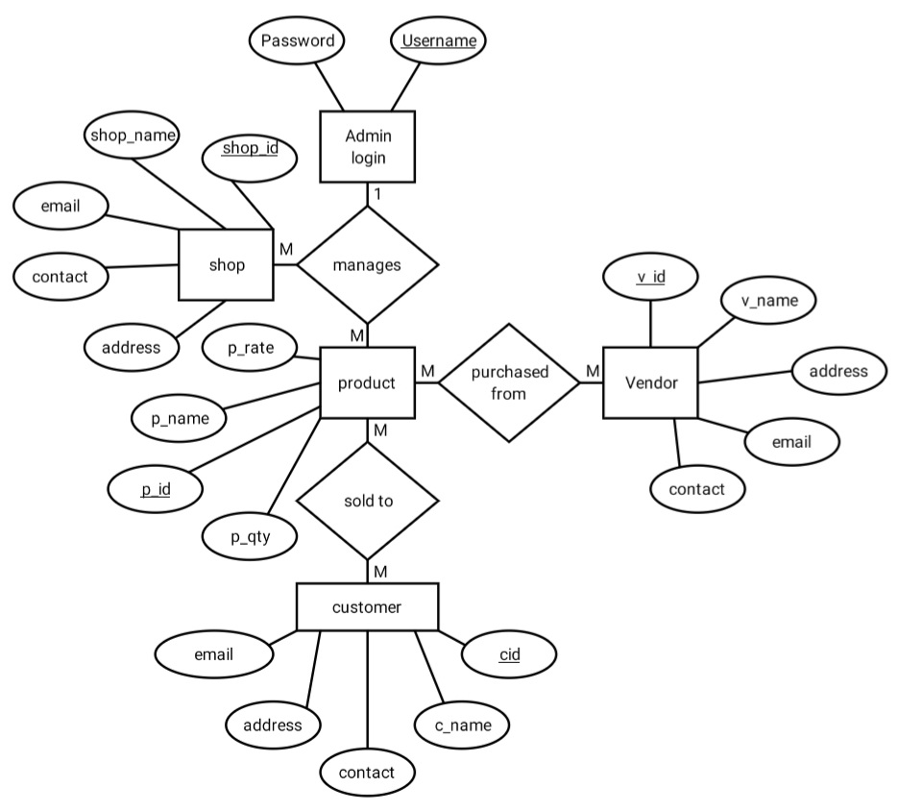
Analysis & Design
ER Diagram :

Slide 11
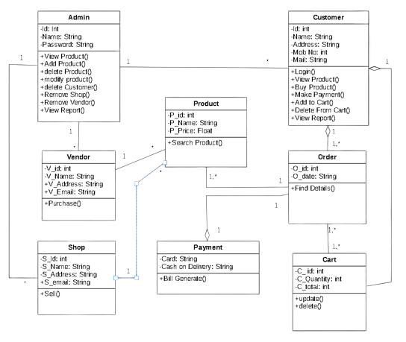
Class Diagram :

Slide 12
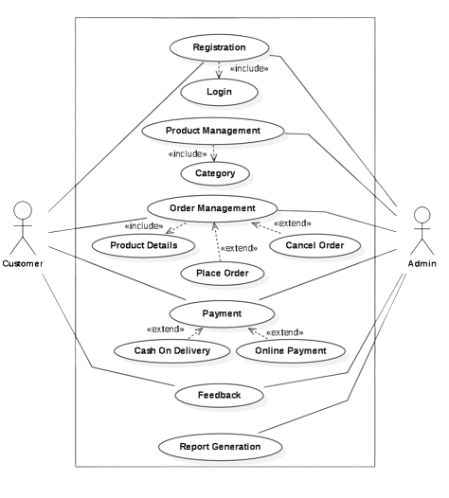
Use Case Diagram :

Slide 13
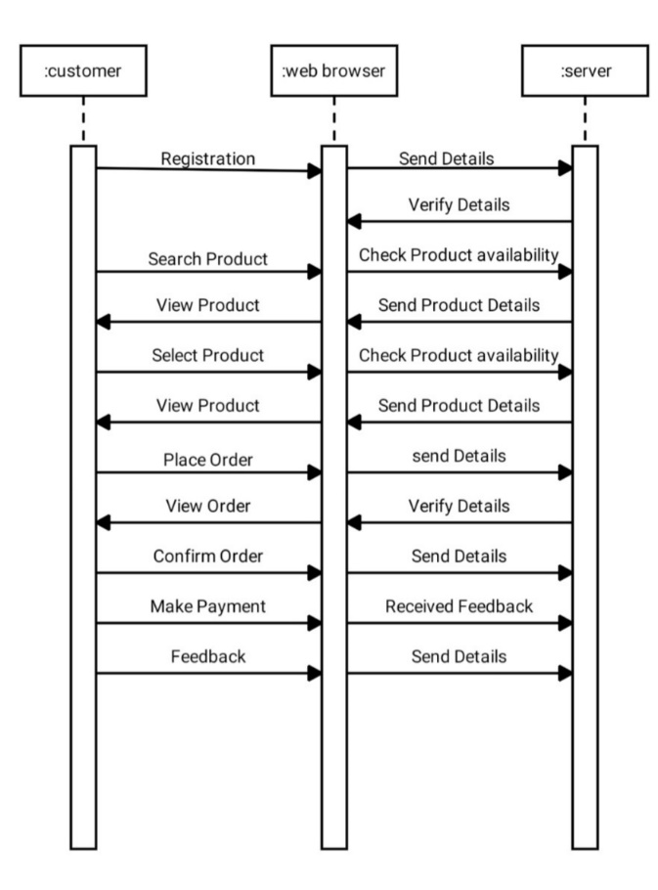
Sequence Diagram :

Slide 14
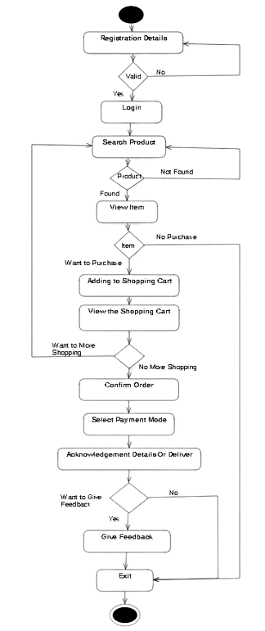
Activity Diagram :

Slide 15
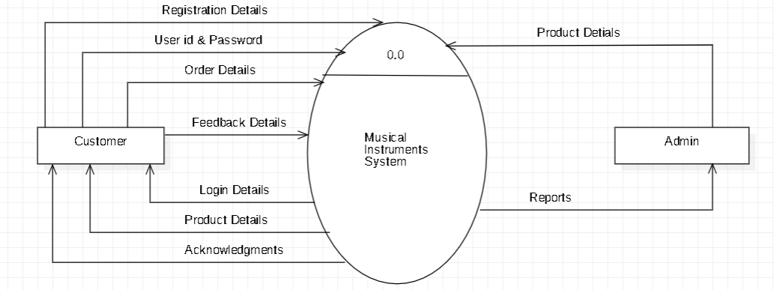
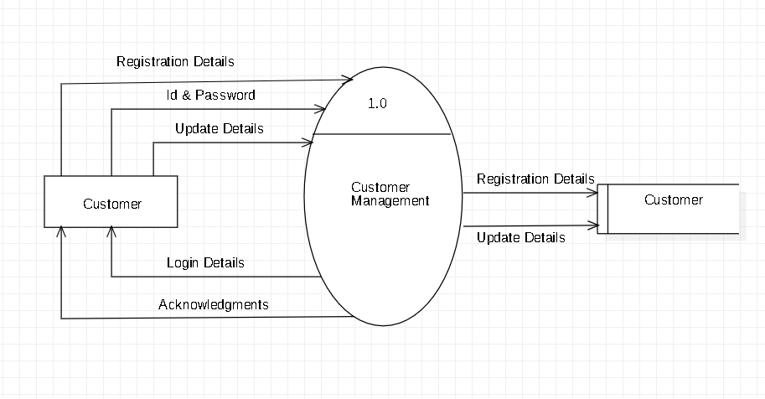
Data Flow Diagram
Level 0 :
Level 1 :

Slide 16
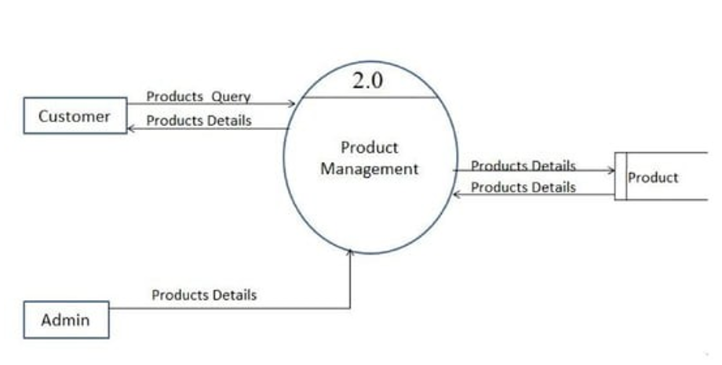
Level 2:

Slide 17
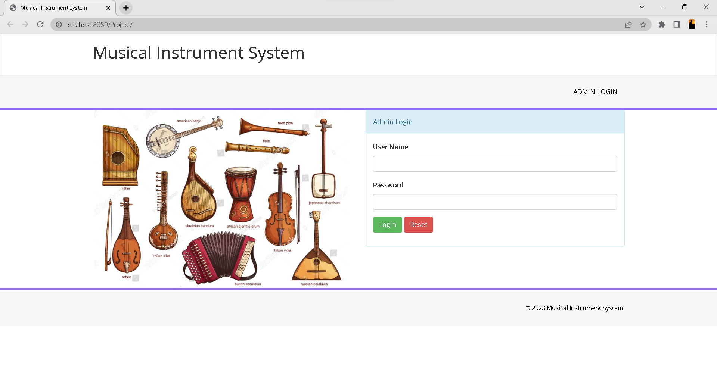
User Interface Design
Admin Login :

Slide 18
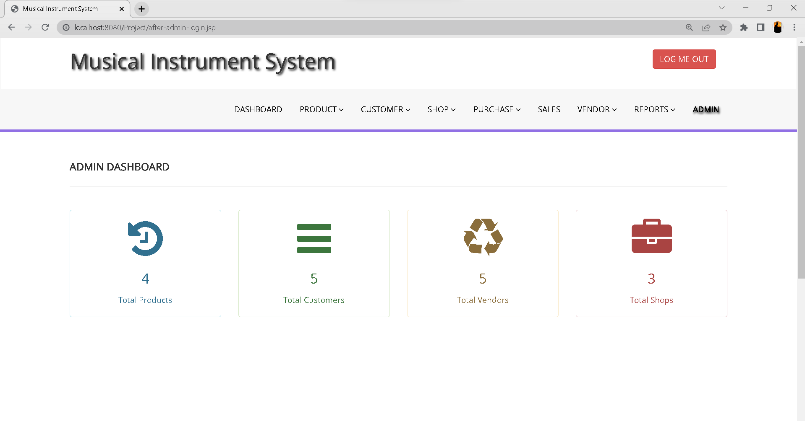
Dashboard :

Slide 19
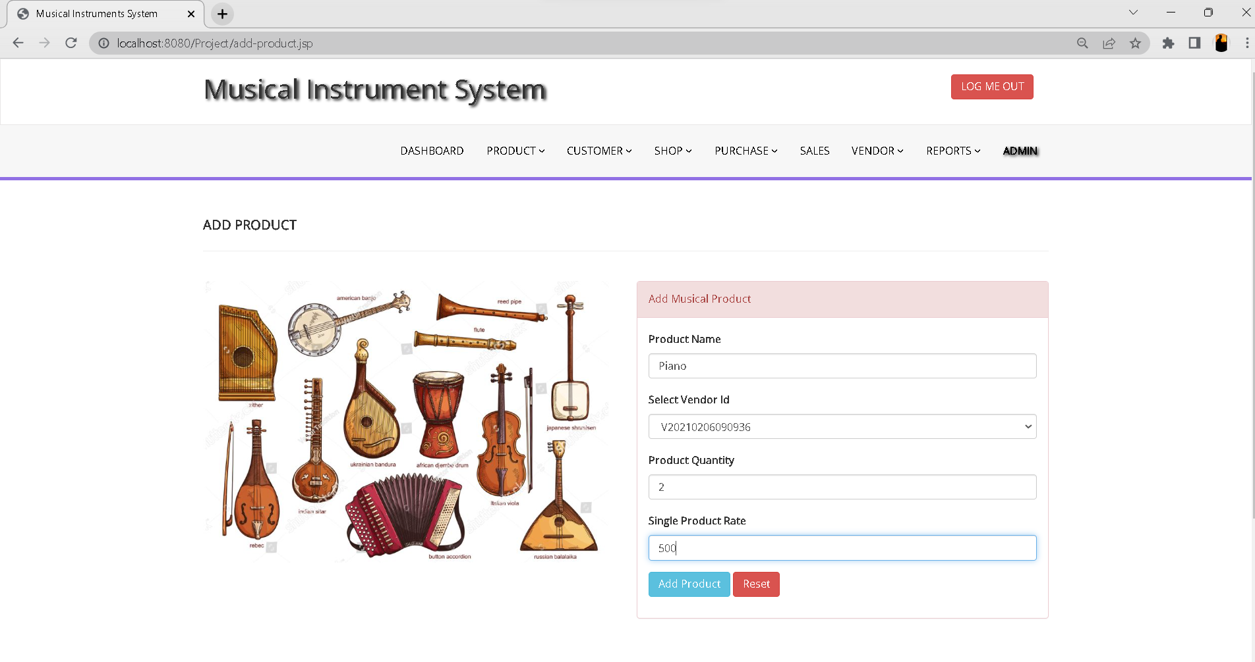
Add Product :

Slide 20
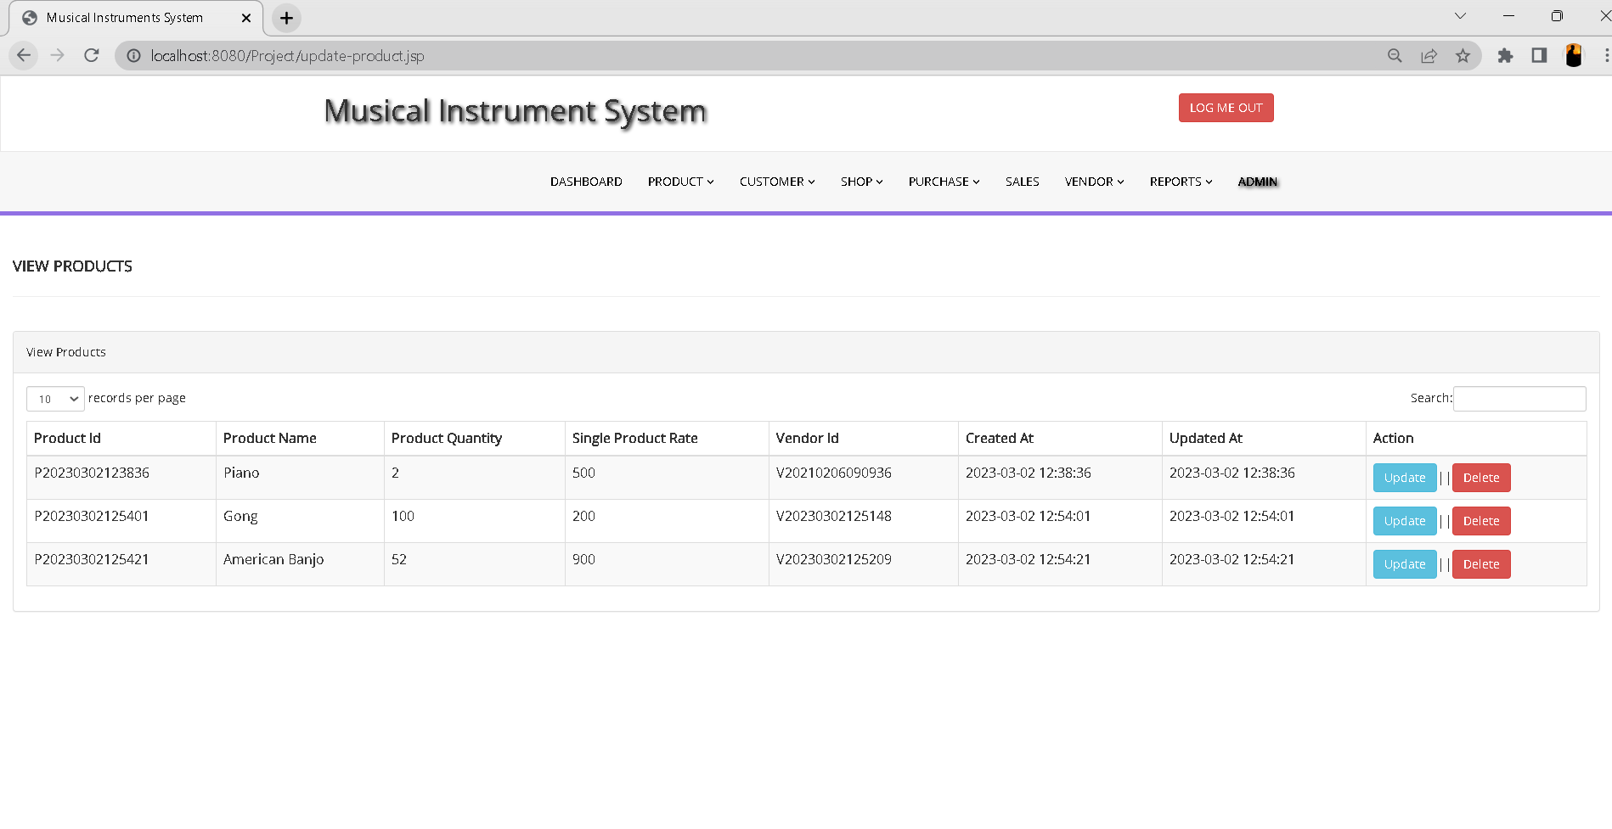
View Product

Slide 21
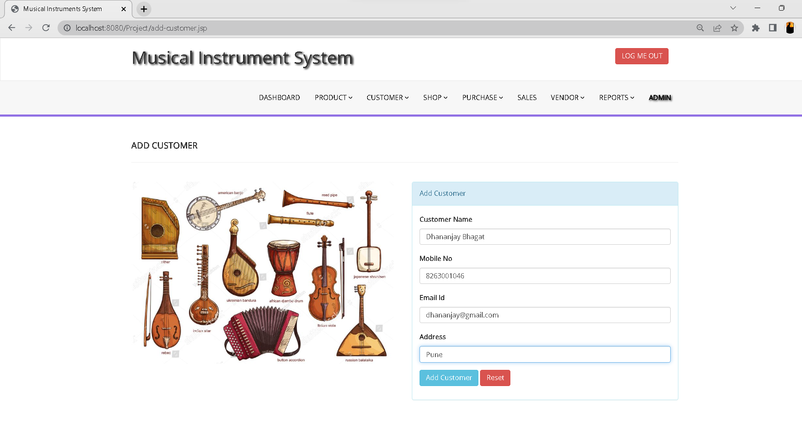
Add Customer

Slide 22
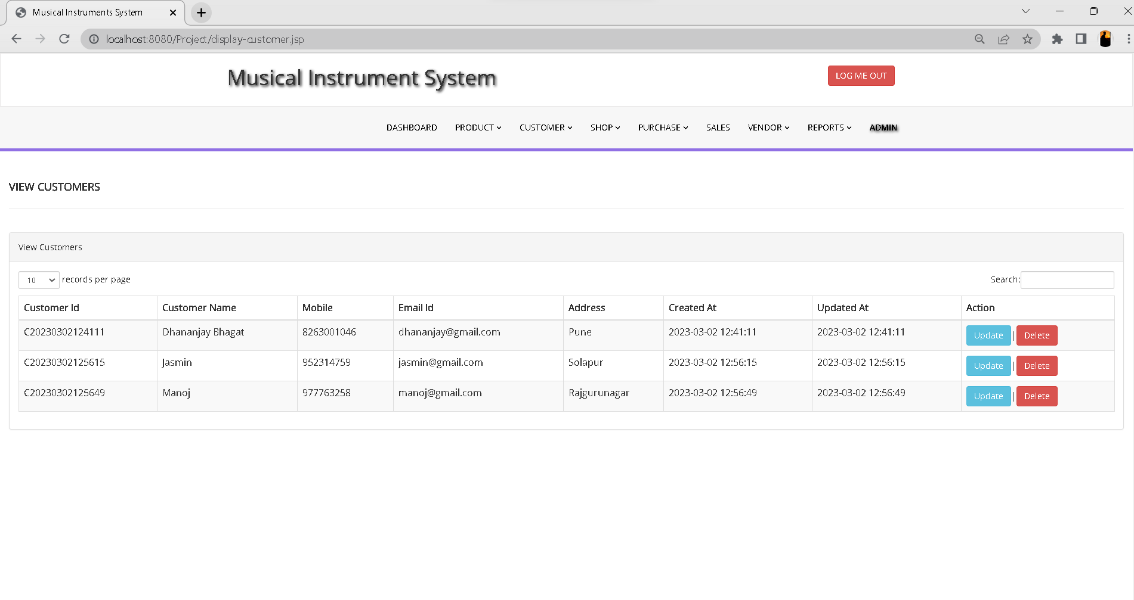
View Customer

Slide 23
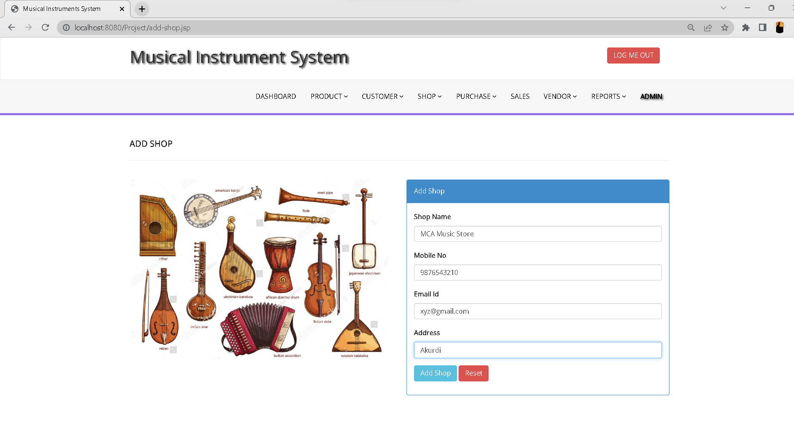
Add Shop

Slide 24
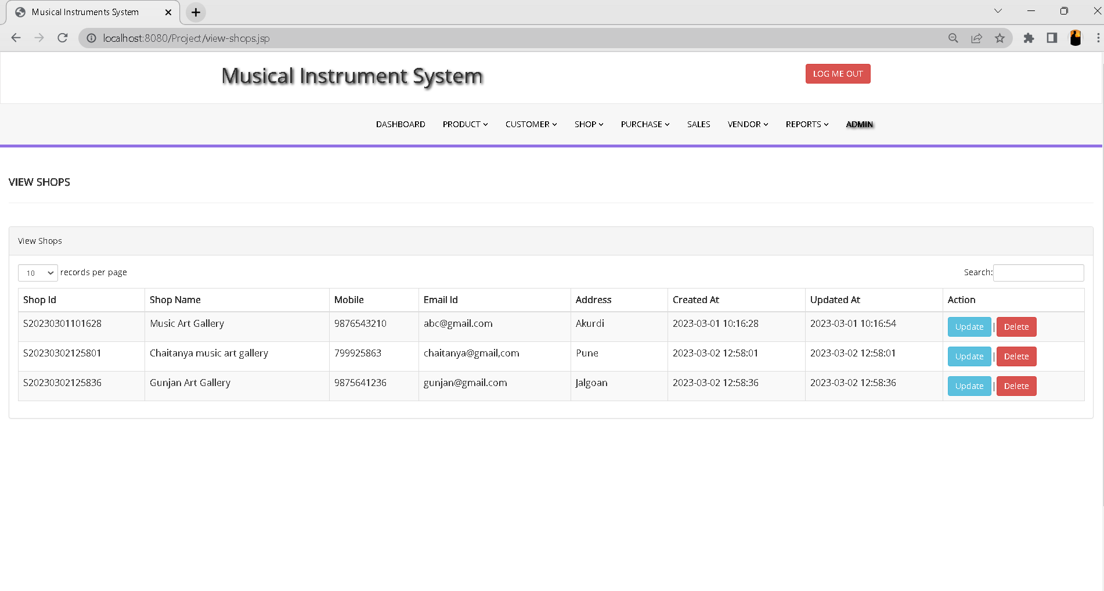
View Shop

Slide 25
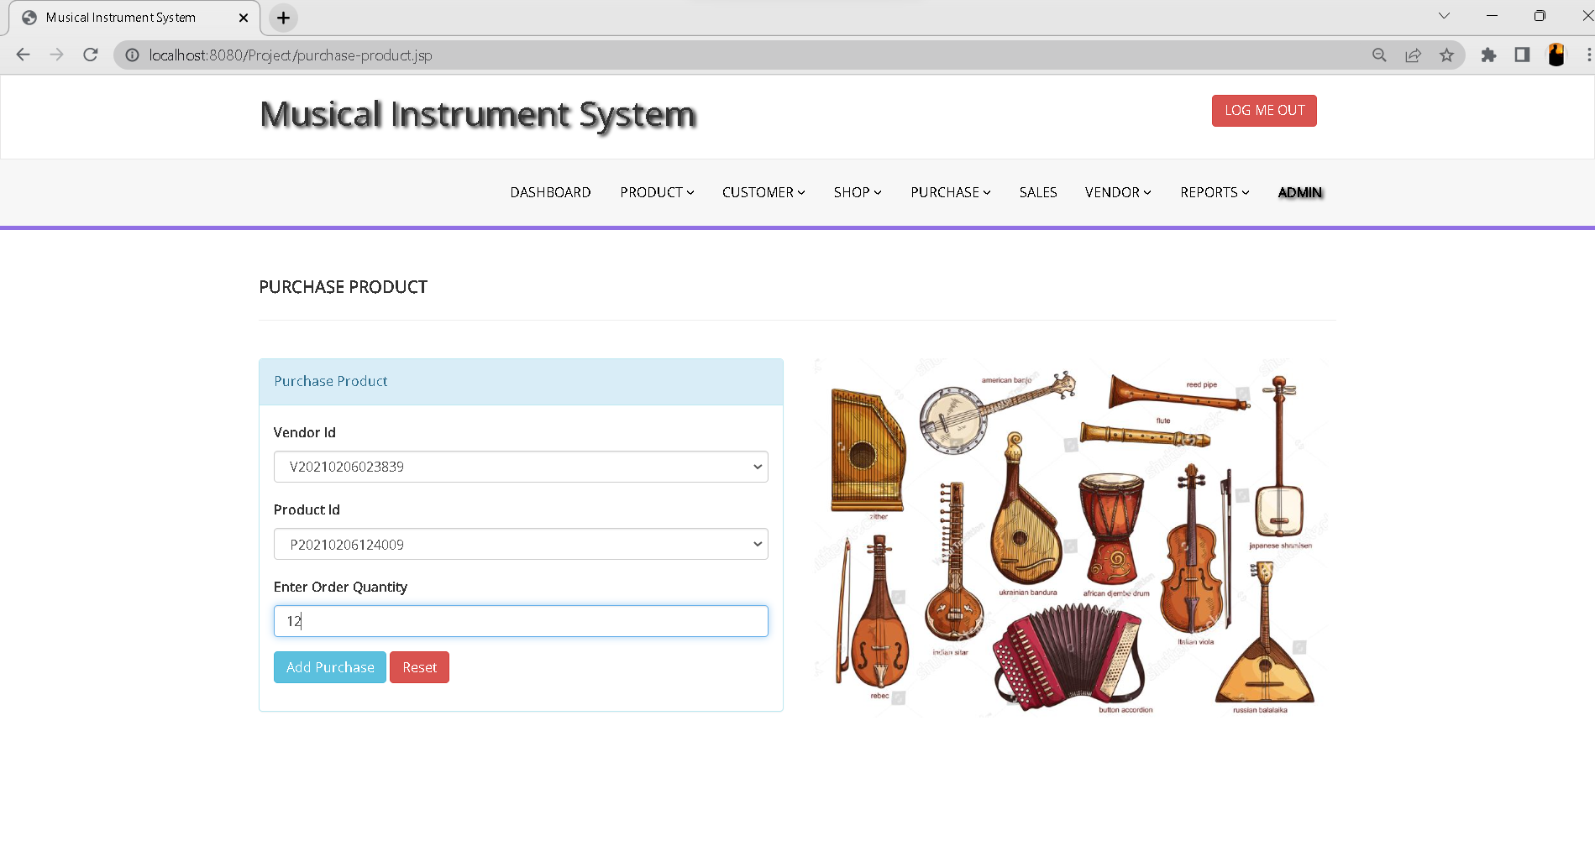
Purchase Product

Slide 26
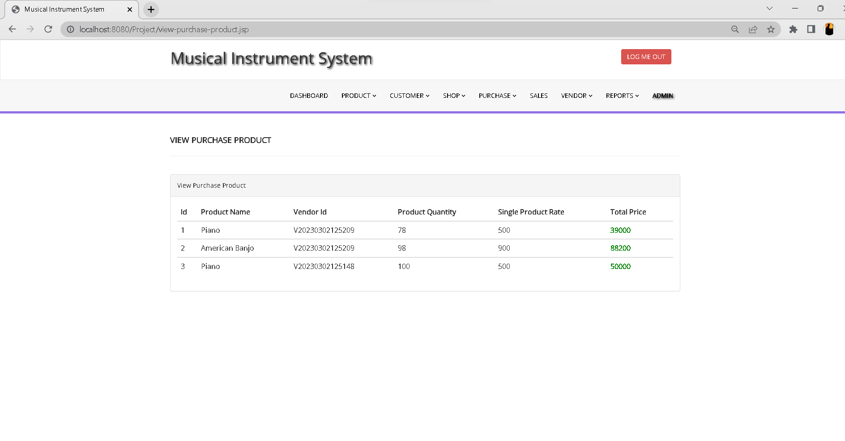
View Purchase Product

Slide 27
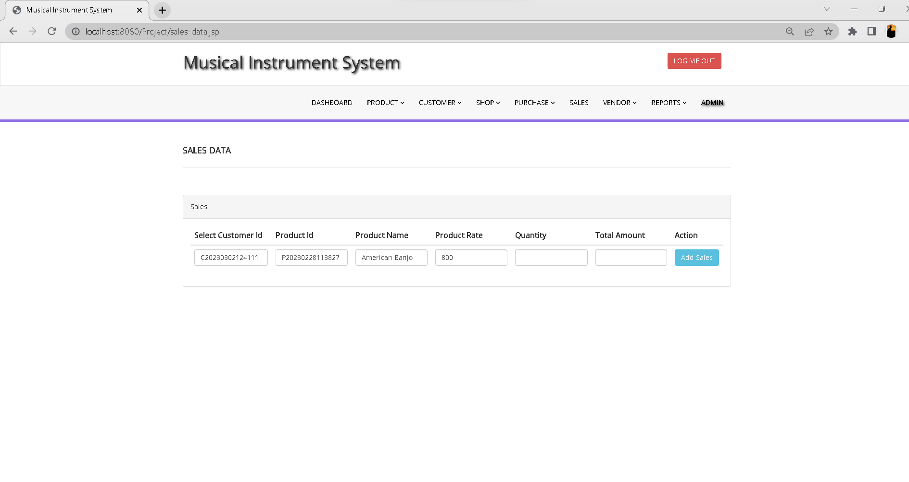
Sales Data

Slide 28
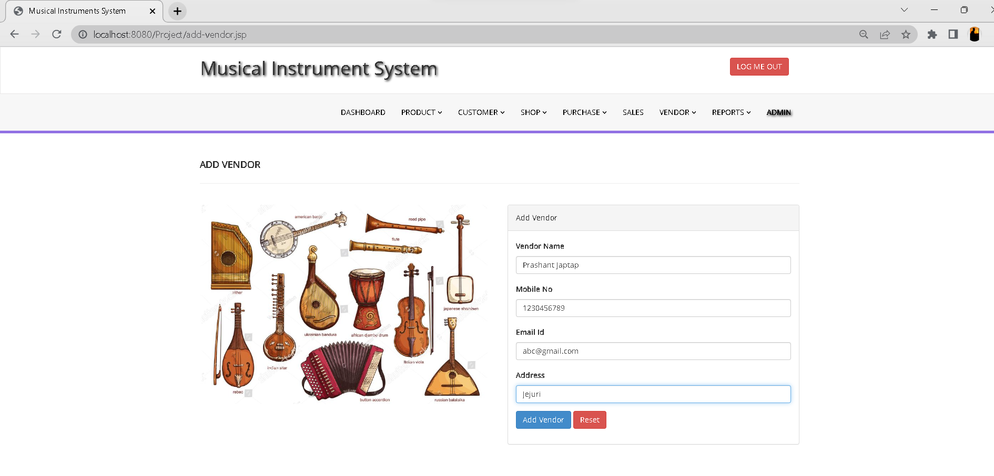
Add Vendor

Slide 29
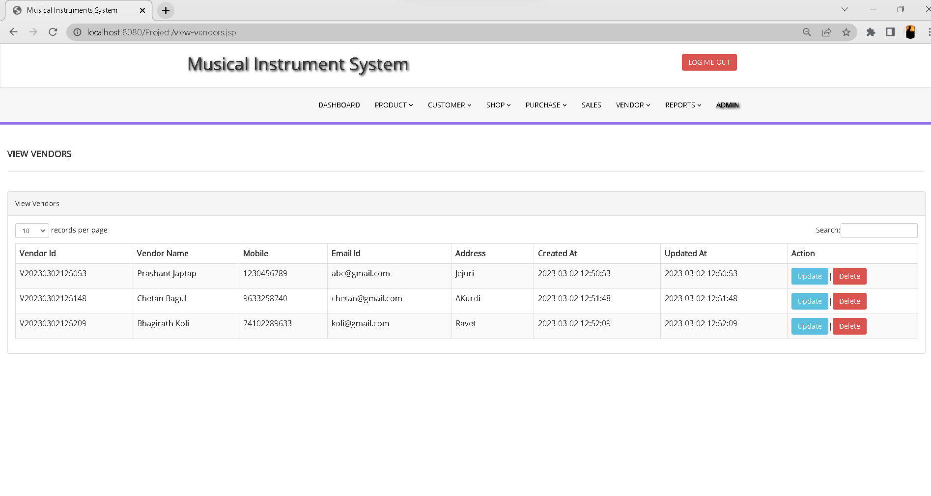
View Vendors

Slide 30
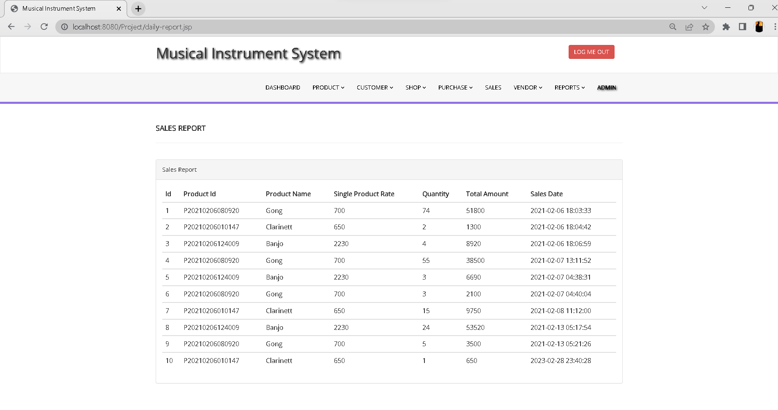
Sales Report

Slide 31
Data Dictionary
Admin Table
Sr.No | Field Name | Data Type | Size | Constraints | Description
1 | Id | Integer | 100 | Primary Key | Admin Id
2 | Uname | Varchar | 100 | Not Null | Admin Name
3 | Password | Varchar | 100 | Not Null | Admin Password
4 | Created_at | Timestamp | 20 | Not Null | Current Timestamp

Slide 32
Product Detail Table
Sr.No | Field Name | Data Type | Size | Constraints | Description
1 | Prod_id | Varchar | 100 | Primary key | Product Id
2 | Prod_name | Varchar | 45 | Not Null | Product Name
3 | Prod_qty | Integer | 45 | Not Null | Product Quantity
4 | Prod_rate | Integer | 45 | Not Null | Product Price
5 | Vendor_id | Varchar | 100 | Not Null | Vendor Id
6 | Created_at | Timestamp | 20 | Not Null | Current timestamp
7 | Updated_at | datetime | 8 | Not Null | Updated timestamp
Customer Table
Sr.No | Field Name | Data Type | Size | Constraints | Description
1 | C_id | Varchar | 100 | Primary Key | Customer id
2 | C_name | Varchar | 45 | Not Null | Customer Name
3 | C_contact | Varchar | 45 | Not Null | Customer Contact
4 | C_email | Varchar | 45 | Not Null | Customer Email id
5 | C_address | Varchar | 45 | Not Null | Customer Address
6 | Created_at | Timestamp | 20 | Not Null | Current Timestamp
7 | Updated_at | datetime | 8 | Not Null | Updated Timestamp

Slide 33
Shop Details Table
Sr.No | Field Name | Data Type | Size | Constraints | Description
1 | Shop_id | Varchar | 100 | Primary Key | Shod id
2 | Shop_name | Varchar | 45 | Not Null | Shop Name
3 | Contact | Varchar | 45 | Not Null | Shop Contact
4 | Email | Varchar | 45 | Not Null | Shop Email id
5 | Address | Varchar | 45 | Not Null | Shop Address
6 | Created_at | Timestamp | 20 | Not Null | Current Timestamp
7 | Updated_at | datetime | 8 | Not Null | Update Timestamp
Vendor Table
Sr.No | Field Name | Data Type | Size | Constraints | Description
1 | Vendor_id | Varchar | 100 | Primary Key | Vendor id
2 | Vendor_name | Varchar | 45 | Not Null | Vendor Name
3 | Contact | Varchar | 45 | Not Null | Vendor Contact
4 | Email | Varchar | 45 | Not Null | Vendor Email id
5 | Address | Varchar | 45 | Not Null | Vendor Address
6 | Created_at | Timestamp | 20 | Not Null | Current Timestamp
7 | Updated_At | datetime | 8 | Not Null | Updated Timestamp

Slide 34
Purchase Table
Sr.No | Field Name | Data Type | Size | Constraints | Description
1 | Purchase_id | Varchar | 100 | Primary Key | Purchase id
2 | Vendor_id | Varchar | 100 | Not Null | Vendor id
3 | Prod_id | Varchar | 100 | Not Null | Product id
4 | Order_qty | Integer | 45 | Not Null | Order Quantity
5 | Created_at | Timestamp | 20 | Not Null | Current Timestamp
6 | Updated_at | datetime | 8 | Not Null | Updated Timestamp
Sales Table
Sr.No | Field Name | Data Type | Size | Constraints | Description
1 | Sale_id | Varchar | 100 | Primary Key | Sale id
2 | cid | Varchar | 100 | Not Null | Customer id
3 | Prod_id | Varchar | 100 | Not Null | Product id
4 | Prod_name | Varchar | 45 | Not Null | Product Name
5 | Quantity | Integer | 45 | Not Null | Quantity
6 | Prod_rate | Integer | 100 | Not Null | Product Price
7 | Total_amt | Integer | 100 | Not Null | Total Amount
8 | Created_at | Timestamp | 20 | Not Null | Current Timestamp
9 | Updated_at | datetime | 8 | Not Null | Updated Timestamp

Slide 35
Drawbacks and Limitations
Lack of Physical Interaction: One of the biggest limitations of an online musical instrument selling system is that customers cannot physically interact with the instruments before making a purchase. This can lead to dissatisfaction with the product, as customers may not be able to accurately judge the sound, feel, or quality of the instrument from online images and descriptions.
Limited Accessibility: Online musical instrument selling systems may not be accessible to all potential customers, particularly those who do not have reliable internet access or who are not comfortable making purchases online.
Security Concerns: Online transactions can be vulnerable to security breaches, which can lead to customer data being compromised or stolen. This can result in a loss of trust in the system and a decrease in sales.

Slide 36
Proposed Enhancement
Current system is developed according to current requirements which can be added later. In this, system can be merged with another system to make bigger system invoking many functions on it.
No project is ever complete in itself; there are always minor or major changes in the project according to user requirements.
This project could be enhanced in the sense that it can overcome its limitations in the future as sample scope for enhancement.
Latest electronic and software technologies can help to bring in more enhancement which would help to make the system more user friendly and also help to maintain adequate security.
To make the application as online so that it would be helpful to everyone.

Slide 37
THANK YOU !

